Slide 1
Wikidata.lib
BP2013N2
InfoLunch 04.06.2014

Slide 2
Wikidata.lib
PubSubHubbub
Publisher
Subscriber
Deployment
Wikidata
Property Suggestions
Value Suggestions
Edit Item Page
Evaluation
Hackathon
BP N2

Slide 3
PubSubHubbub
PubSubHubbub (PuSH) is a protocol that enables resources to push changes to subscribers.
Notes:
Warum push?: Pushing > Polling
Warum PubSubHubbub?: Idee von WikiData

Slide 4
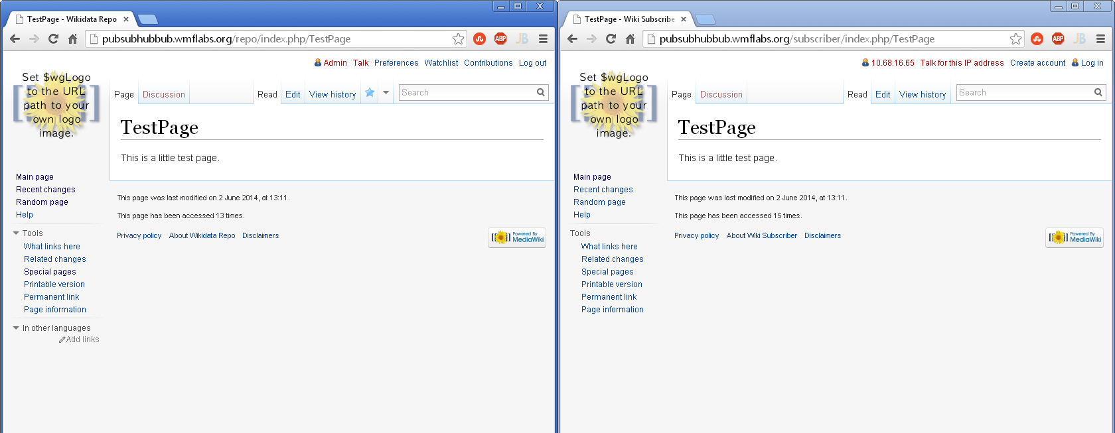
Demo

Slide 5
Detecting Changes
MediaWiki hooks:
NewRevisionFromEditComplete
ArticleDeleteComplete
ArticleRevisionUndeleted
Add two new job to the JobQueue
PublishTitleChanges
PublishAllChanges
When the job is executed: Send a publish event to the hub

Slide 6
Publishing a Change
Publisher client sends an HTTP POST request to the hub
Request contains the following data:
hub.mode=publish& hub.url=http://a.resource.url/& hub.url=http://another.resource.url/ …

Slide 7
Identifying Resources
Every web page can be a resource
Resources need special HTTP headers for identification:
Link: <http://this.is.a.hub/>; rel="hub" Link: <http://this.is.the.resource/>; rel="self"

Slide 8
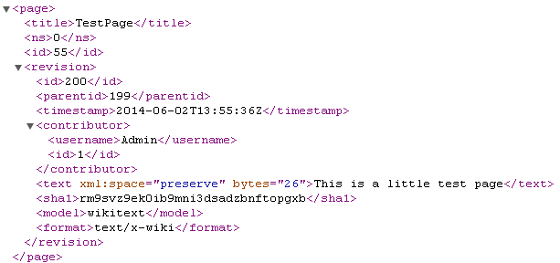
What are our Resources?
MediaWiki Export-XML
All Changes:
in the last x seconds
but y changes tops
For deletions, we export the log-entry

Slide 9
Pushing to Subscribers
Hub sends an HTTP POST request to each subscriber
Request contains special HTTP headers for identification of hub and resource:
Link: <http://this.is.a.hub/>; rel="hub" Link: <http://this.is.the.resource/>; rel="self" X-Hub-Signature: sha1=728b02d392a2bddb7d002f82012a9a8bab4feb1a
New contents of resource are body of the request
Notes:
Hub-Signature: a secret the subscriber sent to the hub when registering for a resource

Slide 10
Subscriber
Check Signature
Create WikiImporter
Register Callbacks
Delete Page Callback
Done
Do Import
Create Redirect Callback

Slide 11
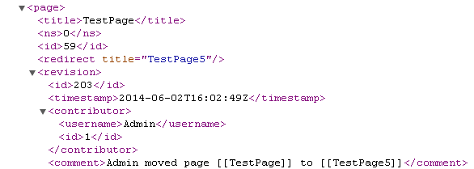
WikiImporter Issues
Parsing the redirect tag
Access to the parsed tag and the content of the tag on hooks
Stream wrapper registered resources multiple times

Slide 12
Deployment
Our publishing component is ready, except the final code review.
Mediawiki wants to take advantage of google hub.
Ask Google if they‘re ok with the load
The individual Wikipedias running behind a proxy.
need to be configured for communication with the hub
Check if there are privacy issues with the deployment on the google hub.
Probably no deployment during our bachelor project time.

Slide 13




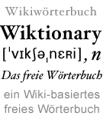
Wikidata

Slide 14
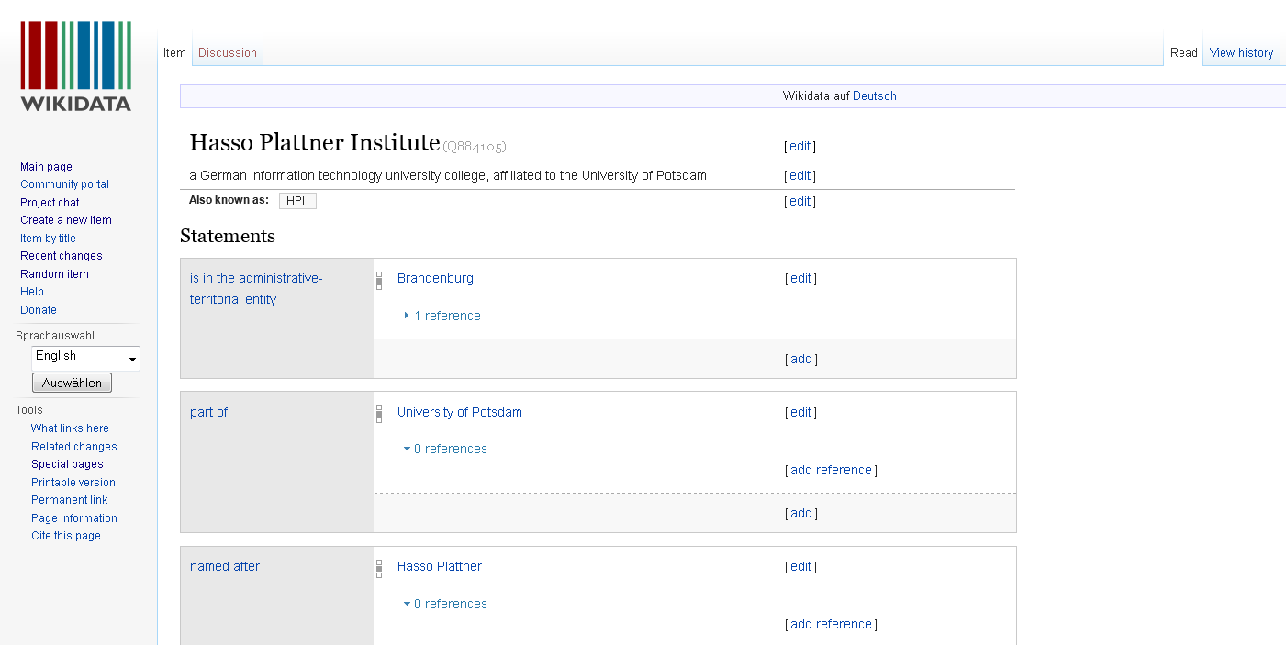
Wikidatas Content: Items

Slide 15
„Statement“ = Property + Value
Recorded and maintained by bots and Wikidata-Users: „Community“

Slide 16
Vision & Goals
Create a common data repository
Support other Wikimedia projects, e.g.. Wikipedia
Centralizing language links
Providing a central place for info box data for all Wikipedias
Creating and updating list articles based on data in Wikidata

Slide 17
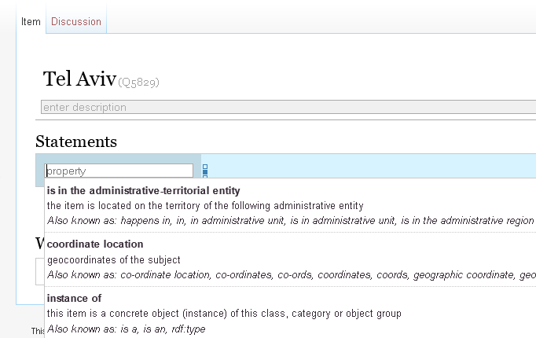
Achievement 1: Property Suggestions
Suggestions

Slide 18
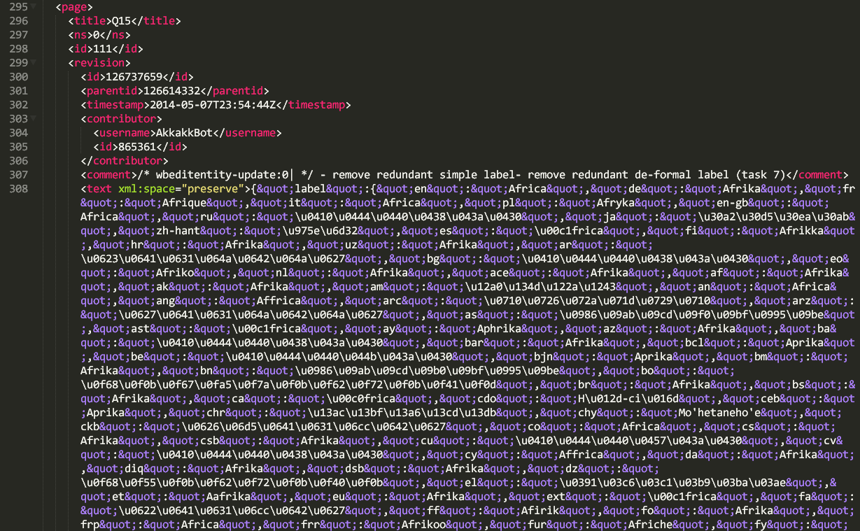
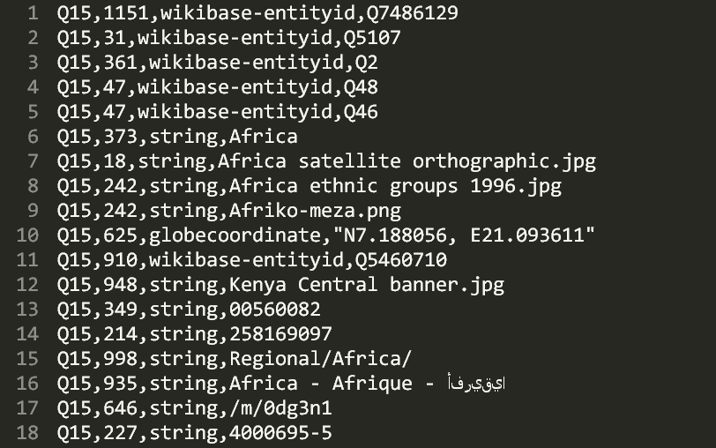
Dump parsing
Wikidata „Pages“ Dump: XML and Json
Reduction and conversion into CSV:
All statements: „subject – predicate – object “ = „Item – Property – Value“
Wikidata DUMP
CSV

Slide 19
Analysis
x
 | 1 | 2 | 3 | 4 | 5 | 6 | 7 | 8 | 9 | 10 | 11
1 | / | 0.2 | 0.4 | / | 0.1 | / | 0.2 | 0.3 | / |  | 0.6
2
3
4 | / | 0.4 | 0.5 | / | 0.7 | / | 0.1 | 0.4 | / |  | 0.5
5
6 | / | 0.8 | 0.9 | / | 0.1 | / | 0.1 | 0.4 | / |  | 0.1
7
8
9 | / | 0.5 | 0.1 | / | 0.2 | / | 0.9 | 0.7 | / |  | 0.1
10
11
y
Count property occurences.
Count property pair occurences.
Calculate:
P(„property x appears in an item whenever property y does“)
CSV

Slide 20
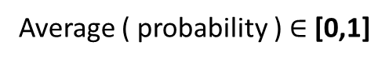
Ranking
Contemplated properties
 | 1 | 2 | 3 | 4 | 5 | 6 | 7 | 8 | 9 | 10 | 11
1 | / | 0.2 | 0.4 | / | 0.1 | / | 0.2 | 0.3 | / |  | 0.6
2
3
4 | / | 0.4 | 0.5 | / | 0.7 | / | 0.1 | 0.4 | / |  | 0.5
5
6 | / | 0.8 | 0.9 | / | 0.1 | / | 0.1 | 0.4 | / |  | 0.1
7
8
9 | / | 0.5 | 0.1 | / | 0.2 | / | 0.9 | 0.7 | / |  | 0.1
10
11
Properties already used in item
score
improvement
…Tf-idf?
Average ( probability ) $∈$ [0,1]

Slide 21
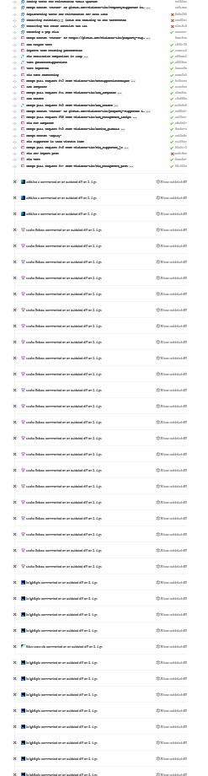
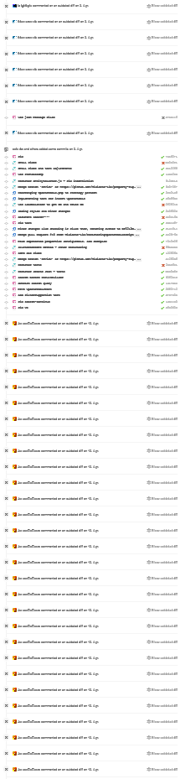
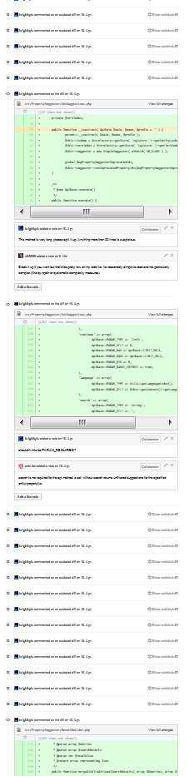
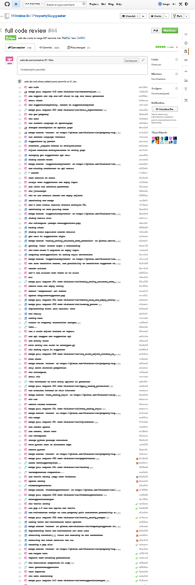
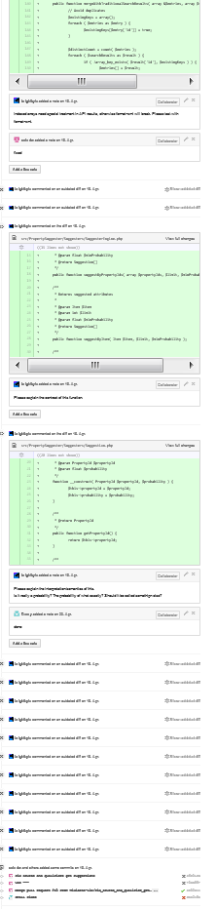

Refactoring
„we'll go ahead and have it
deployed with the next
Wikidata deployment on
June 10th.”

Slide 22
Improvement
Problem:
Instance of and gender occur often together, because a lot of items are humans.
Instance of occurs with a lot of items with another type, too. Cities, movies, …
Thus we suggest human properties for cities, movies…
Solution:
For each Property p: v(p) = count how many other properties p occurs with
Use P(Property x -> Property y) / v(x)
=> give more weight to more specific properties

Slide 23
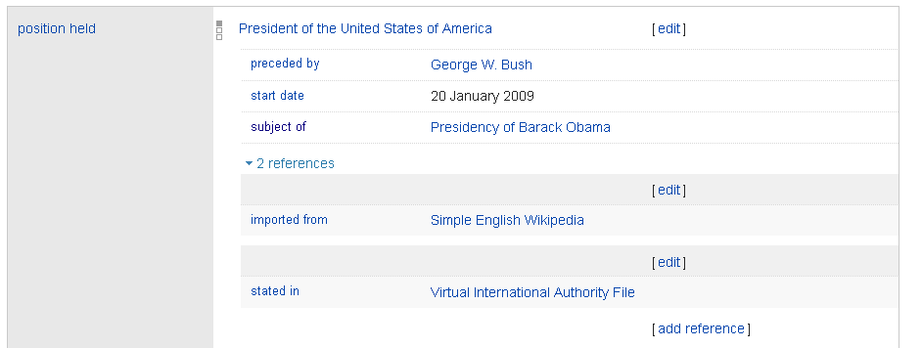
Sources & Qualifiers „Suggestions“

Slide 24
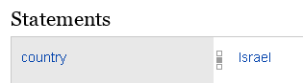
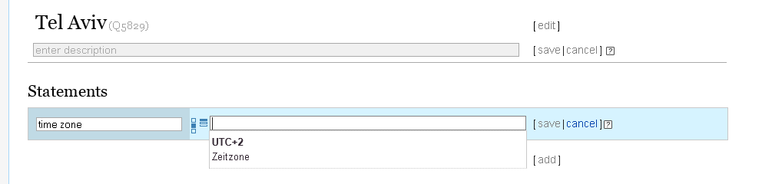
Achievement 2: Item - property dependent item search
WOW!
Magic ;-)

Slide 25
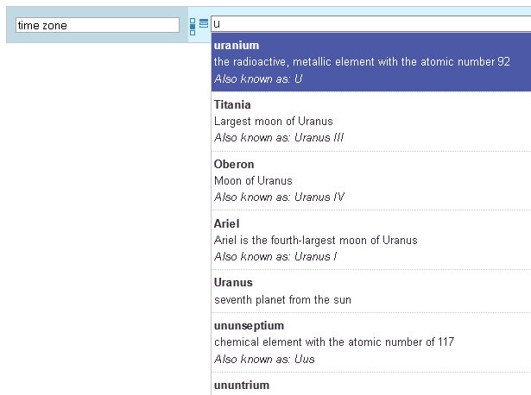
… instead of
Timezone = Uranium,
Titania, Oberon, Ariel,
Uranus, ununseptium,
ununtrium ?

Slide 26
Analysis
Consider Statements with value-type „item“ only.
step1: count statement occurrences
step2: select relevant statements ( #appearance > avg(appearance) x factor )
step3: count statement pair appearances ( only if both statements are “relevant” )
step4: select relevant statement pairs → rules
step5: write to disk
CSV

Slide 27
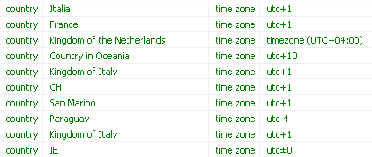


Example rules
Kingdom of Italy?

Slide 28
Suggestions
SELECT rules.s2ValueId as value, ( 1 - EXP(SUM(LOG( 1 - ( rules.probability ) ))) ) as p FROM wbes_statement_pairs as rules WHERE (s1Id, s1ValueId) IN ((31,5),(106, 12204)) AND wbs_propertypairs.pid1 = s1Id AND wbs_propertypairs.pid2 = s2Id AND rules.s2Id = 21 /* gender */ GROUP BY rules.s2ValueId HAVING p > 0.01 ORDER BY p desc
Parameters:
Statements of Item
Property

Slide 29
Example Suggestions first 10
Albert Einstein, Arbeitsgebiet
basketball player
number theory
ice hockey player
mathematical analysis
film director
probability theory
politician
differential geometry
topology
physician

Slide 30
Example Suggestions first 10
Shutter Island, Genre:
thriller
comedy-drama
biographical film
action film
romance film
drama film
fantasy film
teen film
romantic comedy
documentary film

Slide 31
Example Suggestions first 10
Shutter Island (Film), Originalsprache, Suchbegriff: "deu"
German
DEU
Deuteronomy
German Empire
Germans
Deuxoevres
Lufthansa
Das Lied der Deutschen
deuterium
Bundestag of Germany

Slide 32
Achievement 3: Edit Item Page

Slide 33
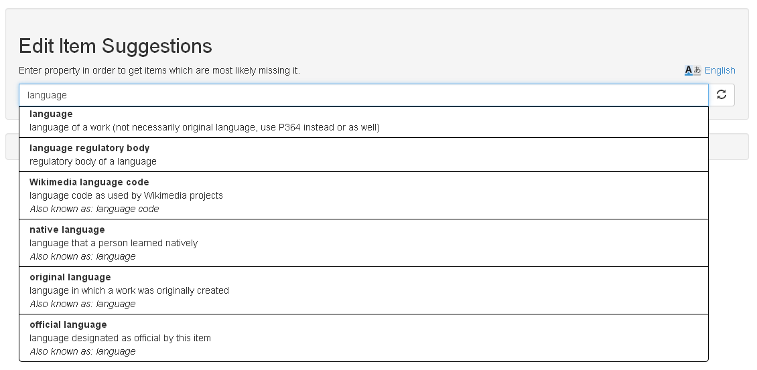
Notes:
Eigenschaft eingeben
Items, wo die Eigenschaft fehlt

Slide 34
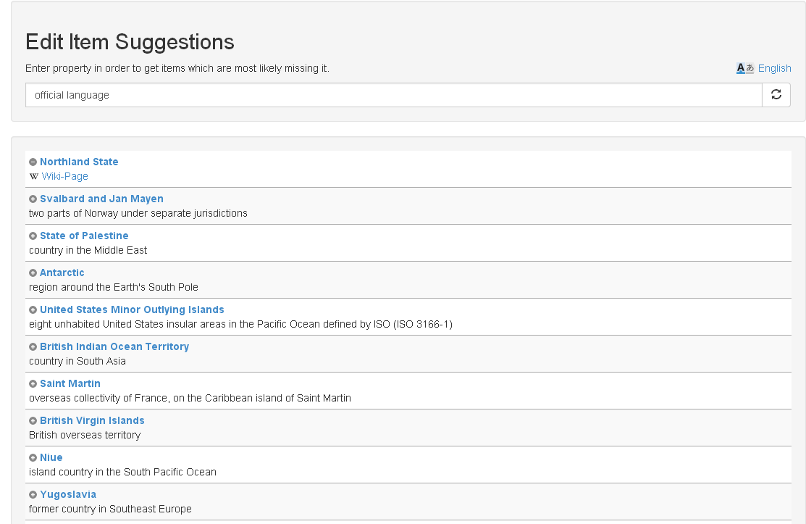
Notes:
Nach 10 min check ob es eingetragen wurde
Verschwindet von Website
Wikipedia Link
Direktes Eintragen
Gute Resonanz auf Wikidata mailingliste

Slide 35
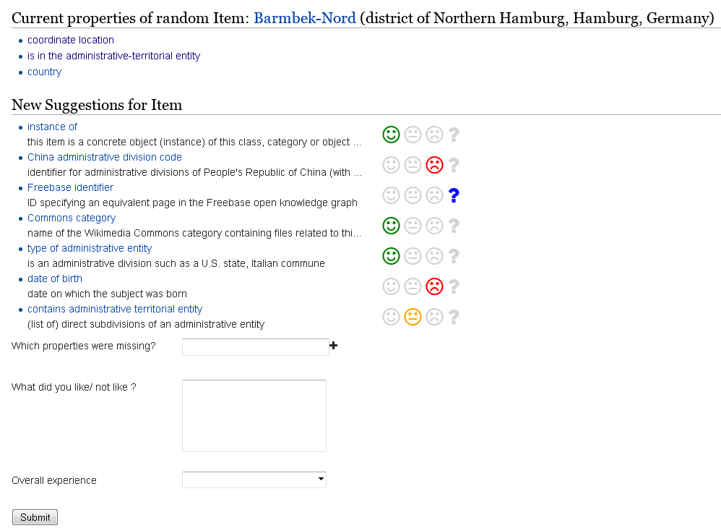
Evaluation

Slide 36
Algorithm
Random Item
Suggester
Property 21
Property 33
Property 8
Property 4
getSuggestions
compare
result
Property 15
Property 4
Property 38
Property 24

Slide 37
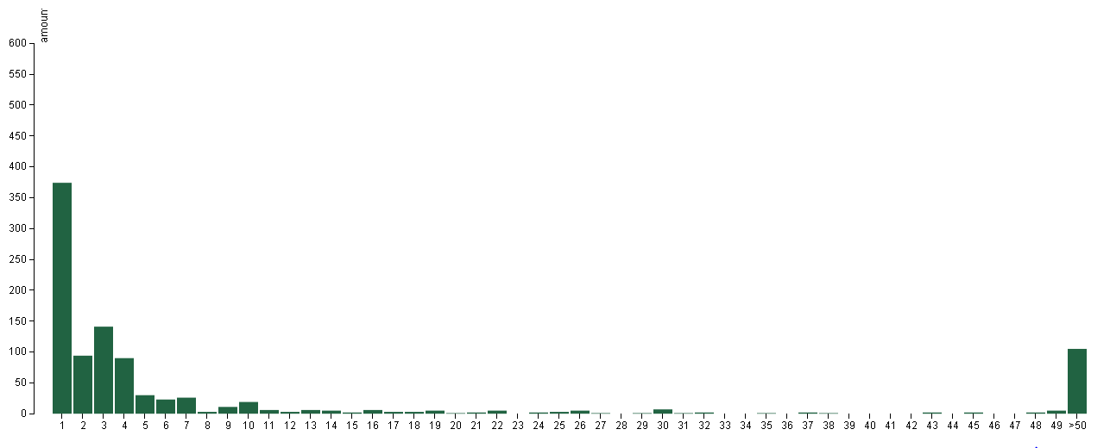
Results

Slide 38
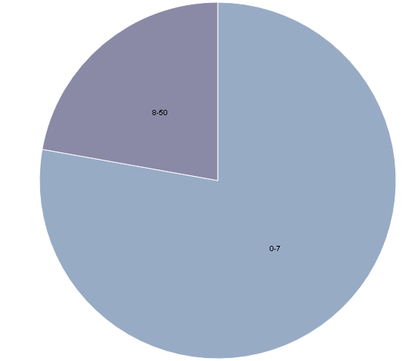
Distribution
8-50
1-7

Slide 39
First letter Algorithm
Random Item
Suggester
Property 21
Property 33
Property 8
Property 4
getSuggestions, search= firstLetter
compare
result
Property 15
Property 4
Property 38
Property 24
Notes:
Extended algorithm:
Provide first letter of missing property as search parameter for suggester
Use Case: User is starting to type

Slide 40
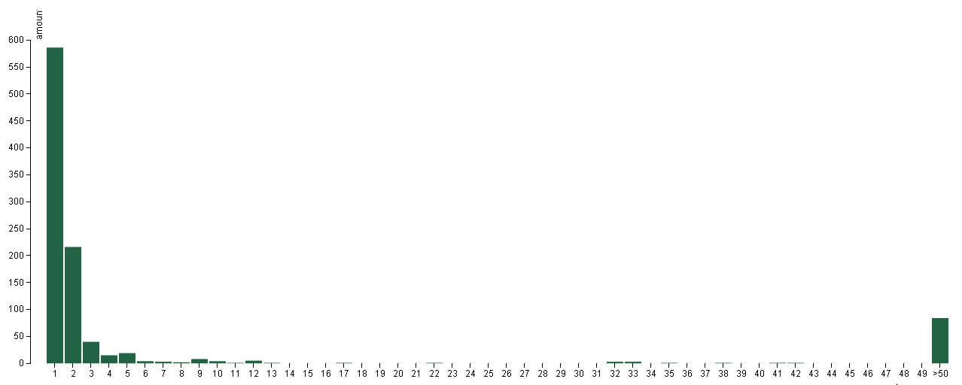
First letter evaluation

Slide 41
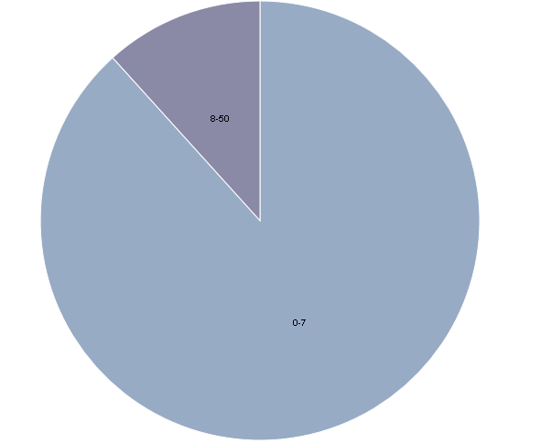
Distribution
8-50
1-7
Notes:
Blau: 1-7
Evaluator
Python
Modular structure to easily extend existing implementation
Visualization
d3.js
bar chart and pie chart
processes csv file

Slide 42
User Feedback Evaluation
User feedback
Created a website for feedback
User ranks suggestions
Wikidata mailing list: 100 evaluations
Until now:
29 participants, 309 evaluations
Notes:
Seite zeigen

Slide 43

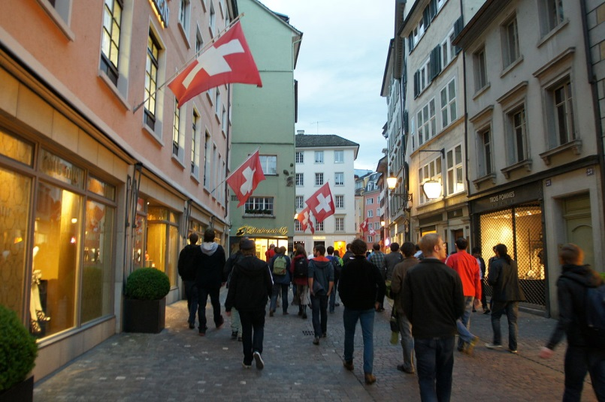
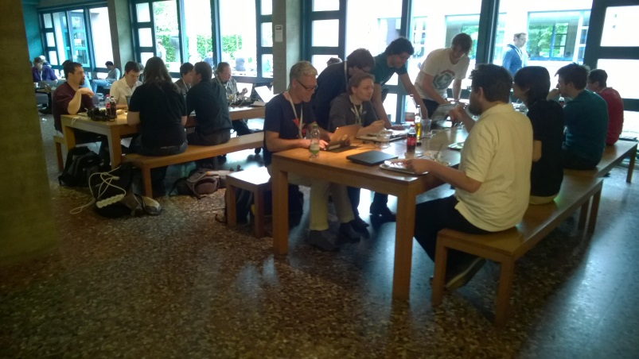
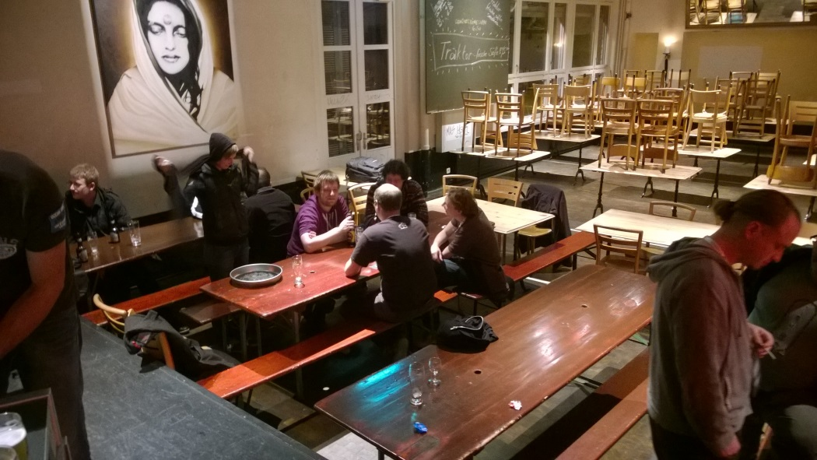
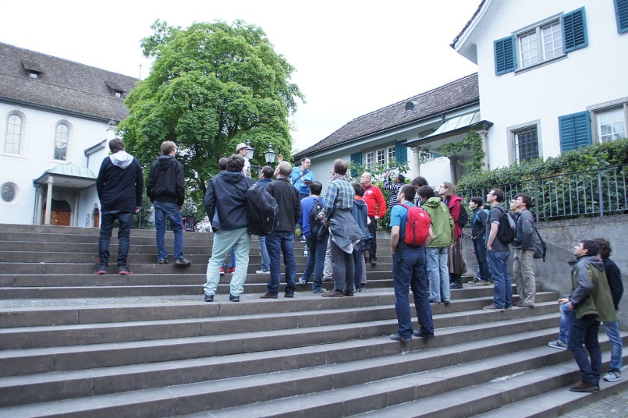

Hackathon Impressions

Slide 44


